Slide 1
Chapter3
Public-Key Cryptography and
Message Authentication

Slide 2
OUTLINE
Math Foundation
Public-Key Cryptography Principles
Public-Key Cryptography Algorithms
Digital Signatures
Key Management
Approaches to Message Authentication
Secure Hash Functions and HMAC

Slide 3
Modular Arithmetic
modulo operator
  “a mod n”: remainder when a is divided by n
congruence: a = b mod n
  a & b have the same remainder when divided by n
  eg. 100 = 34 mod 11
residue of “a mod n”
  b is the residue: a = qn + b
  usually choose the smallest positive remainder as residue
    ie. 0 <= b <= n-1
modulo reduction
    eg. -12 mod 7
    = -5 mod 7 = 2 mod 7 = 9 mod 7
Notes:
我们mod出来的数值一定是正的。

Slide 4
Divisors
A non-zero number b divides a if
  for some m have a=mb (a,b,m all integers)
  b divides into a with no remainder
  denoted as b|a
  b is a divisor of a
    eg. all of 1,2,3,4,6,8,12,24 divide 24
Notes:
Divisor 因数

Slide 5
Modular Arithmetic Operations
A type of 'clock arithmetic'
uses a finite number of values, and loops back from either end
modular arithmetic
  addition & multiplication
  Apply modulo reduction at any point
    a+b mod n = [a mod n + b mod n] mod n
Notes:
Modular arithmetic 模运算
最重要的一个性质就是a+b mod n = [a mod n + b mod n] mod n

Slide 6
Modular Arithmetic
modular arithmetic
  Applied to any group of integers
    Z_{n} = {0, 1, … , n-1}
  form a commutative ring for addition
  with a multiplicative identity
some properties
  if (a+b)=(a+c) mod n
  then b=c mod n
  but if (a.b)=(a.c) mod n
  then b=c mod n only if a is relatively prime to n
Notes:
Note some more important properties of modular arithmetic, as discussed further in the text.

Slide 7
Prime Numbers
prime numbers only have divisors of 1 and self
  they cannot be written as a product of other numbers
  note: 1 is prime, but is generally not of interest
  eg. 2,3,5,7 are prime, 4,6,8,9,10 are not
prime numbers are central to number theory
list of prime number less than 200 is:
  2 3 5 7 11 13 17 19 23 29 31 37 41 43 47 53 59 61 67 71 73 79 83 89 97 101 103 107 109 113 127 131 137 139 149 151 157 163 167 173 179 181 191 193 197 199
Notes:
A central concern of number theory is the study of prime numbers. Indeed, whole books have been written on the subject. An integer p>1 is a prime number if and only if its only divisors are 1 and itself. Prime numbers play a critical role in number theory and in the techniques discussed in this chapter. Stallings Table 8.1 (excerpt above) shows the primes less than 2000. Note the way the primes are distributed. In particular note the number of primes in each range of 100 numbers.

Slide 8

Prime Factorization
factor a number n
  a product of other numbers: n=a x b x c
  factoring a number is relatively hard compared to multiplying the factors together to generate the number
prime factorization of a number n
  a product of primes
    eg. 91=7x13 ; 3600=2⁴x3²x5²
Notes:
The idea of "factoring" a number is important - finding numbers which divide into it. Taking this as far as can go, by factorising all the factors, we can eventually write the number as a product of (powers of) primes - its prime factorisation. Note also that factoring a number is relatively hard compared to multiplying the factors together to generate the number.

Slide 9
Public-Key Cryptography Principles
The use of two keys has consequences
  key distribution, confidentiality and authentication.
The scheme has six ingredients
  Plaintext
  Encryption algorithm
  Public key
  private key
  Ciphertext
  Decryption algorithm

Slide 10
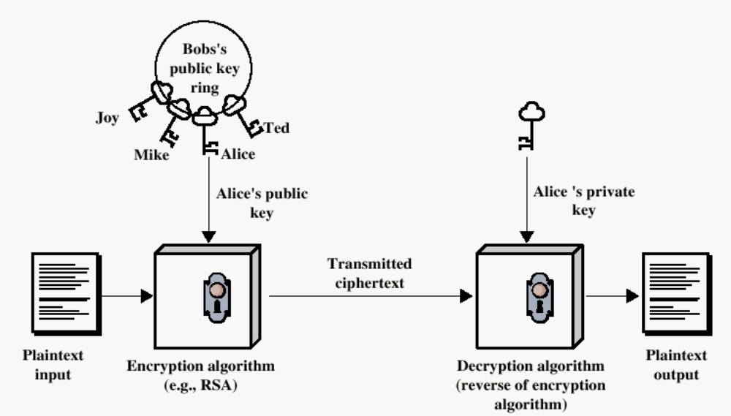
Encryption using Public-Key system

Slide 11
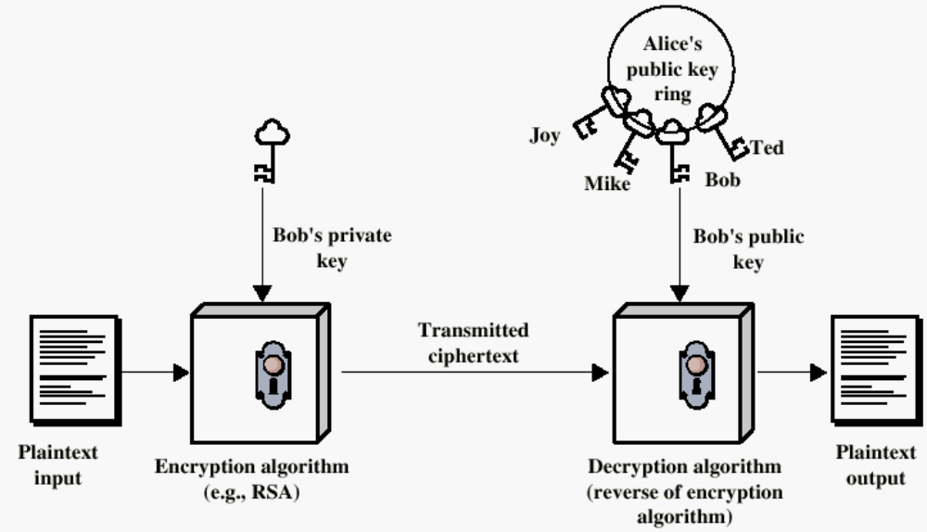
Authentication using Public-Key System

Slide 12

Public-Key Cryptosystems
Notes:
Stallings Figure 9.4 “Public-Key Cryptosystems: Secrecy and Authentication” illustrates the essential elements of a public-key encryption scheme.
Note that public-key schemes can be used for either secrecy or authentication, or both (as shown here).
In this case, separate key pairs are used for each of these purposes. The receiver owns and creates secrecy keys, sender owns and creates authentication keys.
In practice typically DO NOT do this, because of the computational cost of public-key schemes. Rather encrypt a session key which is then used with a block cipher to encrypt the actual message, and separately sign a hash of the message as a digital signature - this will be discussed more later.

Slide 13
Applications for Public-Key Cryptosystems
Three categories:
  Encryption/decryption
    The sender encrypts a message with the recipient’s public key.
  Digital signature
    The sender ”signs” a message with its private key.
  Key exchange
    Two sides cooperate to exhange a session key.
Notes:
可以应用公钥体系的三个场景：加解密、数字签名和密钥交换

Slide 14
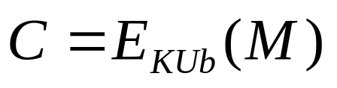
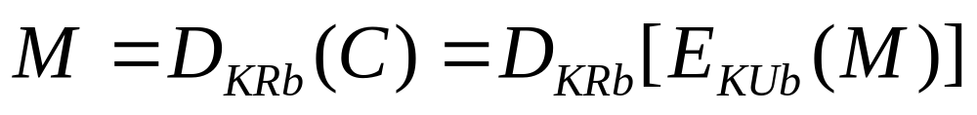
Requirements for Public-Key Cryptography
Computationally easy for a party B to generate a pair (public key KUb, private key KR_{b})
Easy for sender to generate ciphertext:
Easy for the receiver to decrypt ciphertect using private key:

Slide 15
Requirements for Public-Key Cryptography
Computationally infeasible to determine private key (KR_{b}) knowing public key (KU_{b})
Computationally infeasible to recover message M, knowing KU_{b} and ciphertext C
Either of the two keys can be used for encryption, with the other used for decryption:

Slide 16
Security of Public Key Schemes
brute force exhaustive search attack
  theoretically possible
  similar to secret key schemes
  keys used are very large (>512bits)
    Slower compared to secret key schemes
security relies on
  a large enough difference in difficulty between
    easy (en/decrypt) and
    hard (cryptanalyse) problems
  the hard problem is known, but is made hard enough to be impractical to break

Slide 17
Public-Key Cryptographic Algorithms
RSA and Diffie-Hellman
RSA
  Ron Rives, Adi Shamir and Len Adleman at MIT, 1977
  RSA is a block cipher
  The most widely implemented
Diffie-Hellman
  Exchange a secret key securely
  Compute discrete logarithms
Notes:
RSA和Diffie Hellman是目前使用最广泛的两种公钥算法。

Slide 18
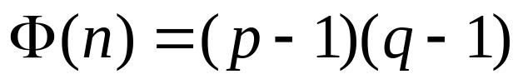
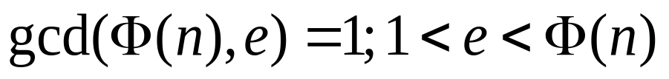
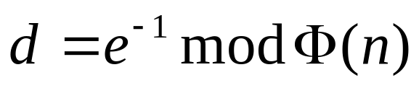
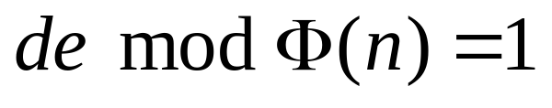
RSA Algorithm (team project)
Select p,q p and q both prime
Calculate n = p x q
Calculate
Select integer e:
Calculate d: ,
Public Key KU = {e,n}
Private key KR = {d,n}
Plaintext: M < n
Ciphertext: C = Me (mod n)
Ciphertext: C
Plaintext: M = C^{d} (mod n)
Notes:
选择与├ 𝛷(𝑛)互素的整数
gcd最大公约数

Slide 19
Why RSA Works
because of Euler's Theorem:
  a^{ø(n)}mod n = 1 where gcd(a,n)=1
RSA:
  n=p.q
  ø(n)=(p-1)(q-1)
  carefully chose e & d to be inverses mod ø(n)
    e.d=1+k.ø(n) for some k
  Prove C^{d} = M mod n?
  C^{d} = M^{e.d} = M^{1+k.ø(n)} = M¹.(M^{ø(n)})^{k}
= M¹.(1)^{k} = M¹ = M mod n
Notes:
Can show that RSA works as a direct consequence of Euler’s Theorem, so that raising a number to power e then d (or vica versa) results in the original number!

Slide 20

Example of RSA Algorithm
Select p = 17, q = 11 (both primes)
Calculate n = p x q = 187
Calculate = 160
Select integer e = 7, relatively prime to 160
Calculate d: dxe mod 160 = 1 → dxe = k 160 + 1
  23 x 7 = 161 = 1 x 160 + 1, d = 23
Public Key KU = {e,n} = {7, 187}
Private key KR = {d,n} = {23, 187}
Notes:
4.选择e，使得e和├ 𝛷(𝑛)互素，经过选取，得到e=7

Slide 21
Example of RSA Algorithm
Given message M = 88 (88 < 187)
  Encryption
    C = 88^7 mod 187 = ?
    = [(88^4 mod 187) x (88^2 mod 187) x (88^1 mod 187)] mod 187
    = [(59,969,536 mod 187) x (7744 mod 187) x (88)] mod 187
    = (132 x 77 x 88) mod 187
    = 894,432 mod 187
    = 11
  Decryption
    M = C^23 mod 187 = 88
    Exponentiation:
    23 = 16 (=8 + 8) + 4 + 2 + 1

Slide 22
Exponentiation
Square and Multiply Algorithm
  repeatedly squaring base
  multiplying in the ones that are needed to compute the result
  a fast, efficient algorithm for exponentiation
binary representation of exponent
  only takes O(log₂ n) multiples for number n
  eg. 7⁵ = 7⁴.7¹ = 3.7 = 10 mod 11
  eg. 3¹²⁹ = 3¹²⁸.3¹ = 5.3 = 4 mod 11
Notes:
平方乘算法
利用mod运算的性质，可以把指数分解成二进制表示，然后分别对每个指数进行mod运算，把最后的余数相乘以后再进行一次mod运算。

Slide 23
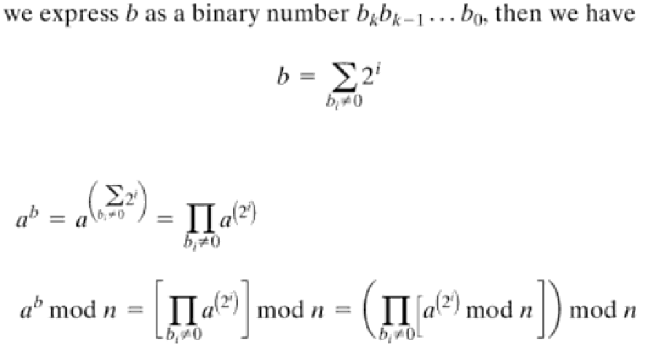
Exponentiation a^b mod n
Notes:
To perform the modular exponentiations, you can use the “Square and Multiply Algorithm”, a fast, efficient algorithm for doing exponentiation.
The idea is to repeatedly square the base, and multiply in the ones that are needed to compute the result, as found by examining the binary representation of the exponent.

Slide 24
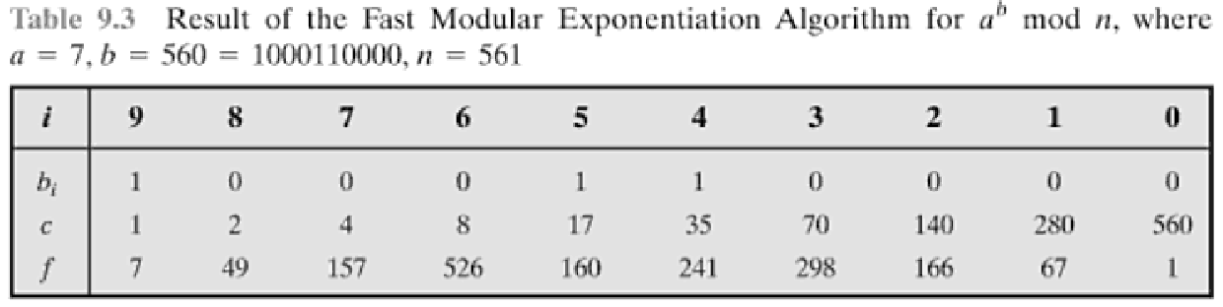
Exponentiation
Algorithm for computing a^b mod n
First represent b as a binary number: bkbk-1…b0.
c = 0; f = 1
for i = k downto 0
do c = 2 x c
f = (f x f) mod n
if b_{i} == 1 then
c = c + 1
f = (f x a) mod n
return f
Notes:
State here one version of the “Square and Multiply Algorithm”, from Stallings Figure 9.7.

Slide 25
Efficient Encryption
Encryption
  C = Me (mod n)
    uses exponentiation to power e
if e small, this will be faster
  often choose e=65537 (2¹⁶-1)
  Let’s also see choices of e=3 or e=17
    but if e too small (eg e=3), attack possible
      using Chinese remainder theorem & 3 messages with different modulii
if e fixed, must ensure gcd(e,ø(n))=1
  i.e. reject any p or q not relatively prime to e
Notes:
To speed up the operation of the RSA algorithm using the public key, can choose to use a small value of e (but not too small, since its then vulnerable to attack).
Must then ensure any p or q chosen are relatively prime to the fixed e (and reject and find another if not), for system to work.

Slide 26
Efficient Decryption
Decryption
  M = C^{d} (mod n)
    uses exponentiation to power d
  this is likely large, insecure if not
  can use the Chinese Remainder Theorem (CRT) to compute mod p & q separately, then combine to get desired answer
    approx 4 times faster than doing directly
    only owner of private key who knows values of p & q can use this technique
Notes:
To speed up the operation of the RSA algorithm using the private key, can use the Chinese Remainder Theorem (CRT) to compute mod p & q separately, and then combine results to get the desired answer. This is approx 4 times faster than calculating “C^d mod n” directly. Note that only the owner of the private key details (who knows the values of p & q) can do this, but of course that’s exactly where help is needed, since if e is small then d will be likely be large!

Slide 27
RSA Key Generation
users of RSA must:
  determine two primes at random - p, q
  select either e or d and compute the other
primes p,q must not be easily derived from modulus n=p.q
  must be sufficiently large
  typically guess and use probabilistic test
exponents e, d are inverses
  use Inverse algorithm to compute the other
Notes:
Before the application of the public-key cryptosystem, each participant must generate a pair of keys, which requires finding primes and computing inverses. Both the prime generation and the derivation of a suitable pair of inverse exponents may involve trying a number of alternatives. Typically make random guesses for a possible p or q, and check using a probabalistic primality test whether the guessed number is indeed prime. If not, try again. Note that the prime number theorem shows that the average number of guesses needed is not too large. Then compute decryption exponent d using Euclid’s Inverse Algorithm, which is quite efficient.

Slide 28
RSA Security
possible approaches to attacking RSA are:
  brute force key search
    infeasible given size of numbers
  mathematical attacks
    based on difficulty of computing ø(n)
    by factoring modulus n
  timing attacks
    on running of decryption
  chosen ciphertext attacks
    given properties of RSA
Notes:
有两种方法可以来攻击RSA算法，第一种是蛮力攻击，也就是试遍所有可能的私钥，所以e和d的比特数越大，算法也就越安全，但反过来看，因为密钥的生成和加解密算法所需的运算都比较复杂，所以密钥越大，系统运行得越慢。

Slide 29
Factoring Problem
3 mathematical attack approaches
  factor n=p.q, hence compute ø(n) and then d
  determine ø(n) directly w/o knowing p&q and compute d
  find d directly w/o determining ø(n)
currently believe all equivalent to factoring
  have seen slow improvements over the years
  currently assume 1024-2048 bit RSA is secure
    ensure p, q of similar size and matching other constraints
Notes:
3种数学的攻击方法：
1.找到一种素数分解的方法

Slide 30
Diffie-Hellman Key Exchange
first public-key type scheme proposed
  by Diffie & Hellman in 1976 along with the exposition of public key concepts
    note: now know that Williamson (UK CESG) secretly proposed the concept in 1970
  is a practical method for public exchange of a secret key
  used in a number of commercial products
Notes:
第一个发表的公钥算法其实是Diffie-Hellman体系，1976年出现在Diffie和hellman的论文之中。
其实后来发现英国的国家信息安全技术权威局的williamson早在1970年就发表了相关的概念。

Slide 31
Diffie-Hellman Key Exchange
a public-key distribution scheme
  cannot be used to exchange an arbitrary message
  rather it can establish a common key
  known only to the two participants
Secret key
  depends on the participants
    their private and public key information
  based on exponentiation in a finite (Galois) field (modulo a prime or a polynomial) - easy
  security relies on the difficulty of computing discrete logarithms (similar to factoring) – hard
Notes:
Diffie-Hellman算法的主要目的是使得两个用户能够安全地交换密钥，供以后加密消息时使用。算法本身是限于密钥交换的。
Diffie-Hellman算法的有效性是建立在建立在计算离散对数是很困难这一基础之上的。

Slide 32
Diffie-Hellman Setup
all users agree on global parameters:
  large prime integer or polynomial q
  α being a primitive root mod q
each user (eg. A) generates their key
  chooses a secret key (number): x_{A} < q
  compute their public key: y_{A} = α^{xA} mod q
each user makes public that key y_{A}
Notes:
简单的定义一下什么叫离散对数：首先，定义素数q的本原根a，则从a的一次方mod q，一直到a的q-1次方mod q各不相同，但他们组成一个1-p-1之间整数的置换。
a mod q， a² mod q，…, a^{q-1} mod q
那对于任意小鱼q的整数y_{A}和q的本原根a，能够找到唯一的的指数x_{A}，使得y_{A} = α^{xA} mod q，因此双方可以公开公钥y_{A}
因此，这个算法有两个公开的数值，素数q和q的本原根a，假设用户A和B希望交换密钥，用户A选择一个随机整数，计算y_{A} = α^{xA} mod q，类似的用户B也选择一个随机整数，计算y_{B} = α^{xB} mod q，双方都保持X值作为私有，向对方公开Y值。

Slide 33
Diffie-Hellman Key Exchange
shared session key for users A & B is K_{AB}:
  K_{AB} = α^{xA.xB} mod q
  = y_{A}^{xB} mod q (which B can compute)
  = y_{B}^{xA} mod q (which A can compute)
K_{AB} is used as session key in private-key encryption scheme between Alice and Bob
if Alice and Bob subsequently communicate, they will have the same key as before, unless they choose new public-keys
To determine the private key of B, attacker must solve discrete log
  XB = dlog α,q (YB)
Notes:
用户A计算密钥K_{A}，用户B计算密钥K_{A}，而两个K是相等的，因此，双方交换密钥K，随后K即可作为双方通信所使用的对称密钥。

Slide 34
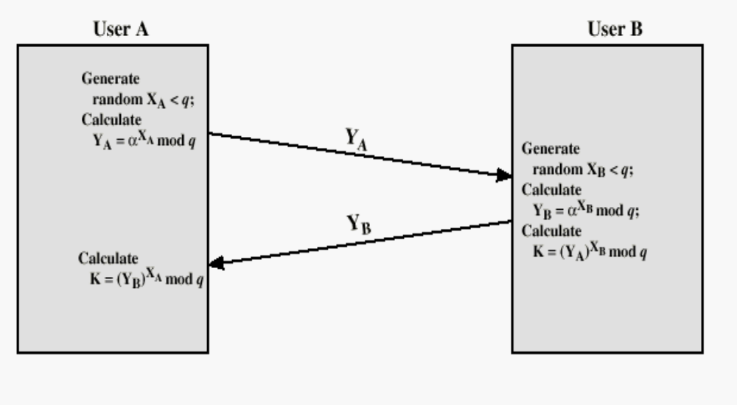
Diffie-Hellman Key Echange
Prove equal?

Slide 35
Diffie-Hellman Example
users Alice & Bob who wish to swap keys:
agree on prime q=353 and α=3
select random secret keys:
  A chooses x_{A}=97, B chooses x_{B}=233
compute respective public keys:
  y_{A}=3⁹⁷ mod 353 = 40 (Alice)
  y_{B}=3²³³ mod 353 = 248 (Bob)
compute shared session key as:
  K_{AB}= y_{B}^{xA} mod 353 = 248⁹⁷ = 160 (Alice)
  K_{AB}= y_{A}^{xB} mod 353 = 40²³³ = 160 (Bob)
Notes:
Here is an example of Diffie-Hellman from the text.

Slide 36
Other Public-Key Cryptographic Algorithms
Digital Signature Standard (DSS)
  Makes use of the SHA-1
  Not for encryption or key echange
Elliptic-Curve Cryptography (ECC)
  Good for smaller bit size
  Low confidence level, compared with RSA
  Very complex

Slide 37
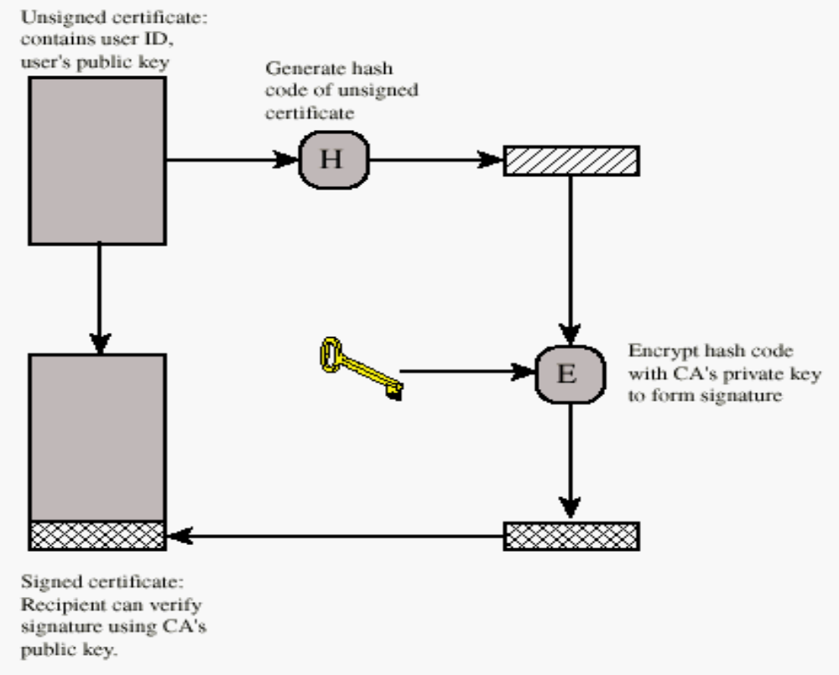
Public-Key Distribution
Digital Certificate

Slide 38
Authentication
Requirements - must be able to verify that:
1. Message came from apparent source or author,
2. Contents have not been altered,
3. Sometimes, it was sent at a certain time or sequence.
Protection against active attack (falsification of data and transactions)

Slide 39
Approaches to Message Authentication
Authentication Using Conventional Encryption
  Only the sender and receiver should share a key
Message Authentication without Message Encryption
  An authentication tag is generated and appended to each message
Message Authentication Code
  Calculate the MAC as a function of the message and the key
  MAC = F(K, M)
Notes:
MAC，消息认证码

Slide 40
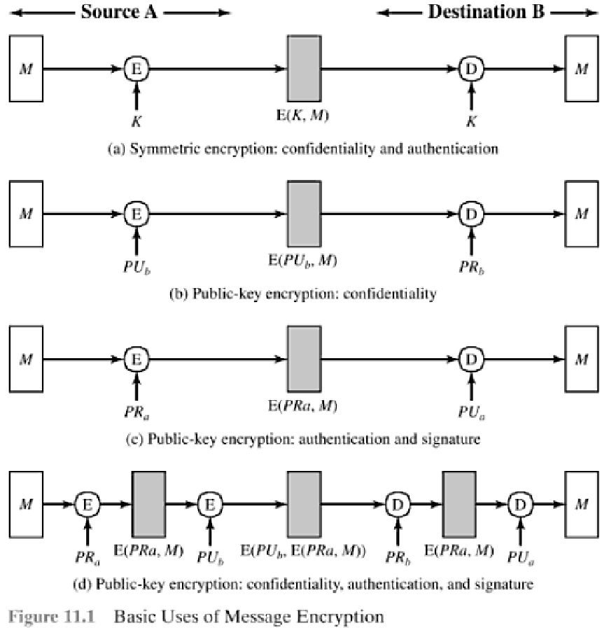
Uses of Message Encryption

Slide 41
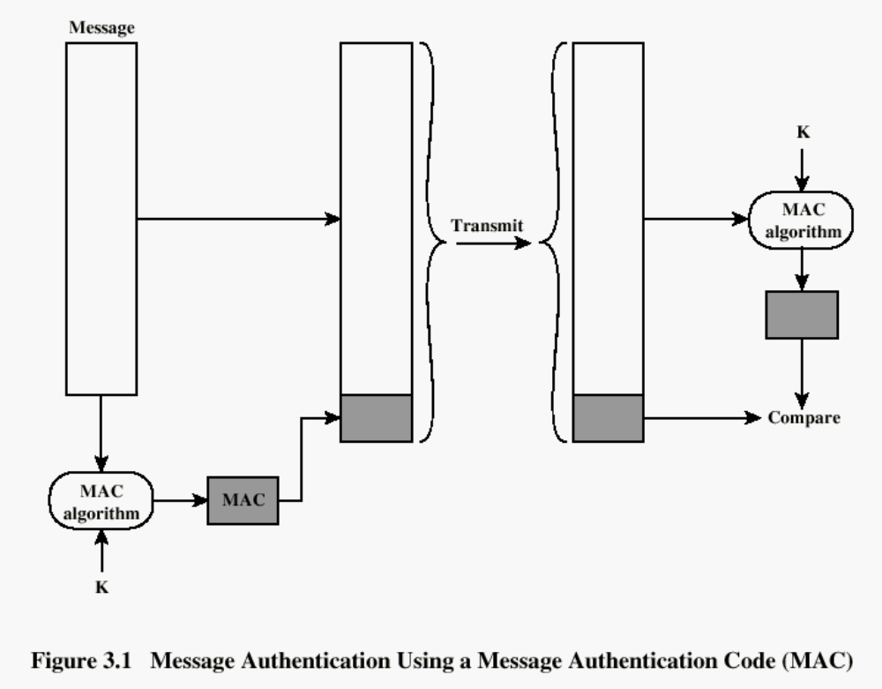

Slide 42
Hash Functions
h = H(M)
  Condenses arbitrary message to fixed size
  usually assume that the hash function is public and not keyed
    MAC needs to be keyed
hash used to
  detect changes to message
    most often to create a digital signature
Notes:
A variation on the message authentication code is the one-way hash function. As with the message authentication code, a hash function accepts a variable-size message M as input and produces a fixed-size output, referred to as a hash code H(M). Unlike a MAC, a hash code does not use a key but is a function only of the input message. The hash code is also referred to as a message digest or hash value.

Slide 43
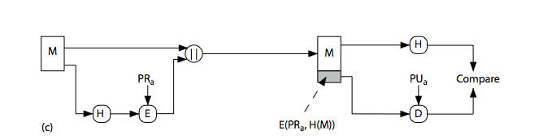
Hash Functions &
Digital Signatures
Notes:
Stallings Figure 11.5c “Basic Uses of Hash Functions” shows the hash being “signed” with the senders private key, thus forming a digital signature.

Slide 44
Requirements for Hash Functions
Purpose of the HASH function is to produce a ”fingerprint”
can be applied to any sized message M
produces fixed-length output h
easy to compute h=H(M) for any message M
given h, infeasible to find x s.t. H(x)=h
    one-way property
given x, infeasible to find y s.t. H(y)=H(x)
    weak collision resistance
infeasible to find any x,y s.t. H(y)=H(x)
    strong collision resistance
Notes:
The purpose of a hash function is to produce a “fingerprint”of a file, message, or other block of data.
These are the specifications for good hash functions. Essentially it must be extremely difficult to find 2 messages with the same hash, and the hash should not be related to the message in any obvious way (ie it should be a complex non-linear function of the message). There are quite a few similarities in the evolution of hash functions & block ciphers, and in the evolution of the design requirements on both.

Slide 45
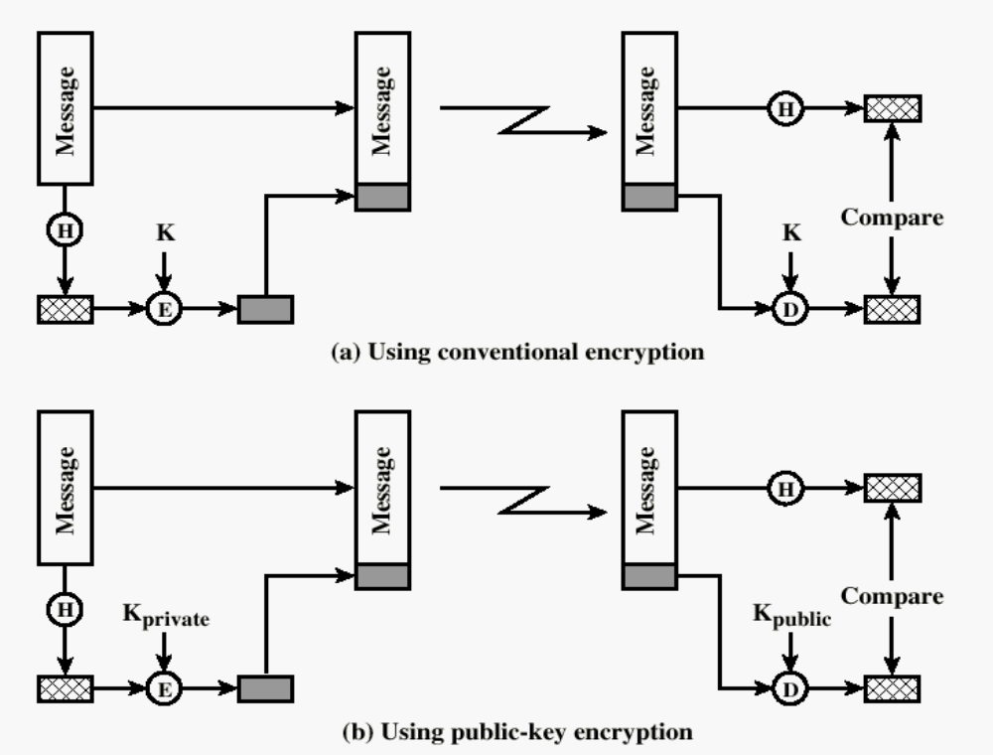
One-way HASH function

Slide 46
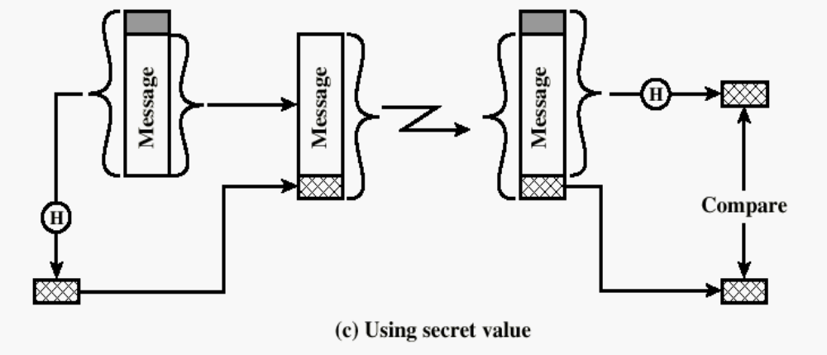
One-way HASH function
Secret value is added before the hash and removed before transmission.

Slide 47
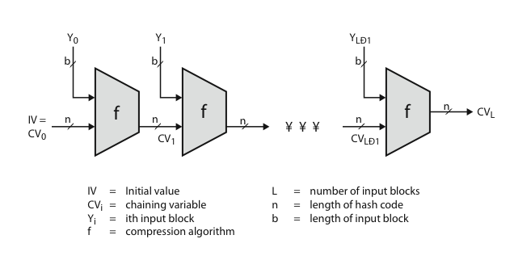
Hash Algorithm Structure
Notes:
Most important modern hash functions follow the basic structure shown in this figure, Stallings Figure 11.9. This has proved to be a fundamentally sound structure, and newer designs simply refine the structure and add to the hash code length. Within this basic structure, two approaches have been followed in the design of the compression function, as mentioned previously, which is the basic building block of the hash function.

Slide 48
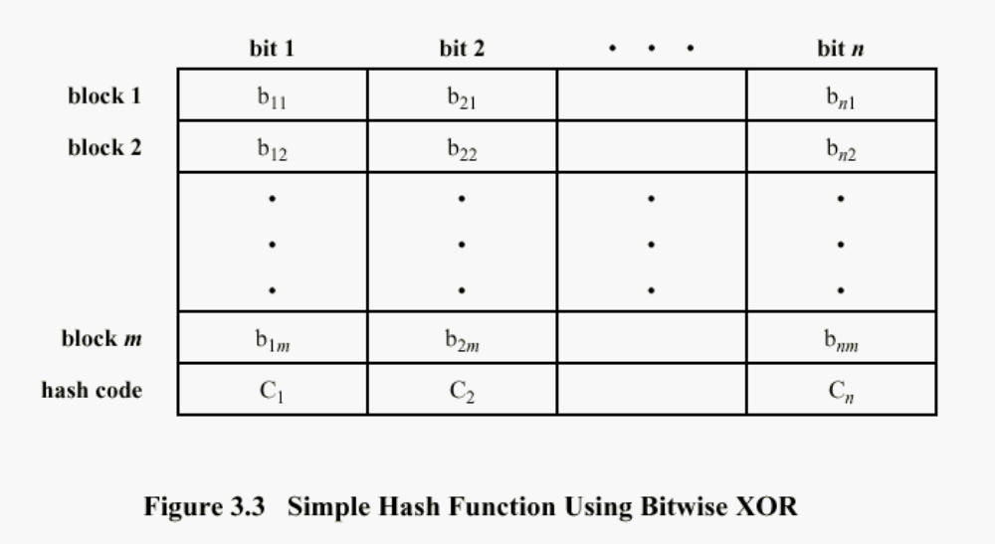
Simple Hash Function
Improvement
  One-bit circular shift on the hash value after each block is processed

Slide 49
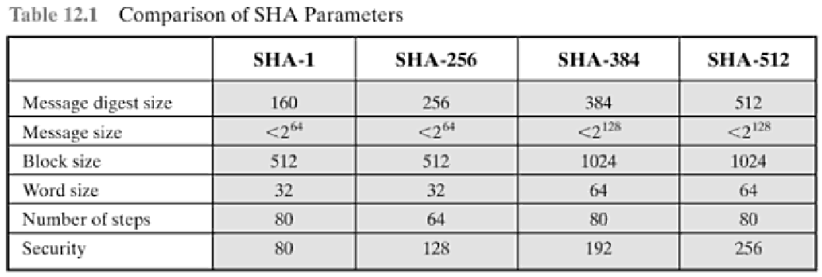
Secure Hash Algorithm
SHA
  originally designed by NIST & NSA in 1993
  revised in 1995 as SHA-1
  based on design of MD4 with key differences
3 additional versions of SHA
  SHA-256, SHA-384, SHA-512
    structure & detail is similar to SHA-1
Notes:
The Secure Hash Algorithm (SHA) was developed by the National Institute of Standards and Technology (NIST) and published as a federal information processing standard (FIPS 180) in 1993; a revised version was issued as FIPS 180-1 in 1995 and is generally referred to as SHA-1. The actual standards document is entitled Secure Hash Standard. SHA is based on the hash function MD4 and its design closely models MD4. SHA-1 produces a hash value of 160 bits. In 2005, a research team described an attack in which two separate messages could be found that deliver the same SHA-1 hash using 2^69 operations, far fewer than the 2^80 operations previously thought needed to find a collision with an SHA-1 hash [WANG05]. This result should hasten the transition to newer, longer versions of SHA.

Slide 50
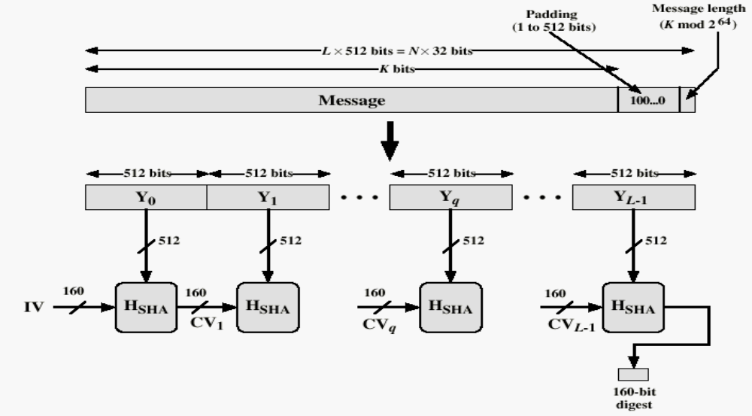
Message Digest Generation Using SHA-1
Step 1: append padding bits 100..0
Step 2: Append original msg length (128 bits)
Total length is a multiple of 512 bits
Step 3: Initialize hash buffer (IV)
Step 4: Process msg in 512-bit blocks

Slide 51
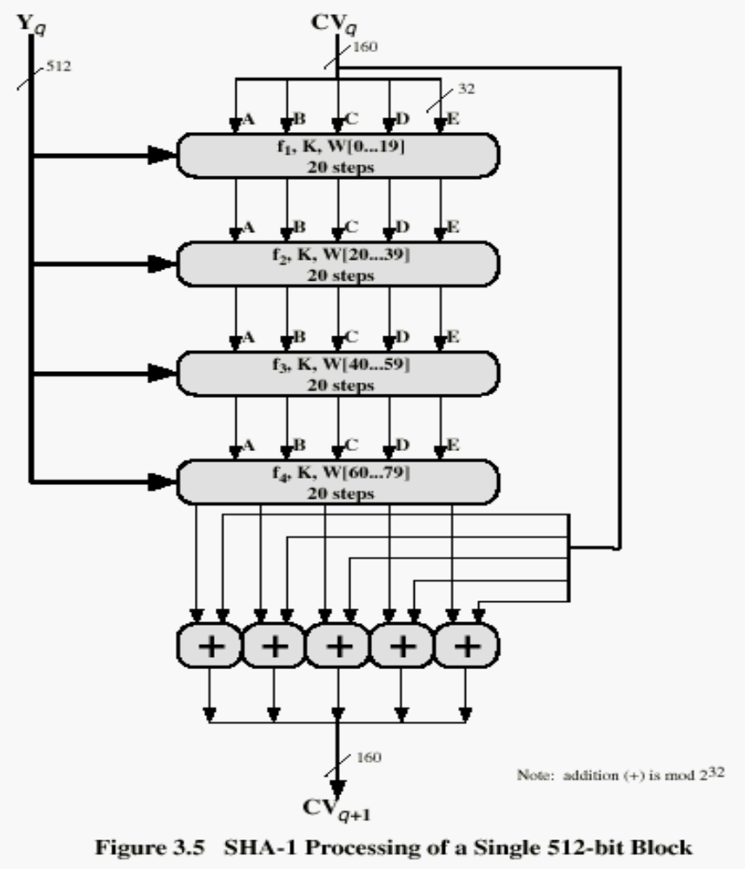
SHA-1 Processing of single 512-Bit Block

Slide 52

Comparison of Secure HASH functions
 | SHA-1 | MD5 | RIPEMD-160
Digest length | 160 bits | 128 bits | 160 bits
Basic unit of processing | 512 bits | 512 bits | 512 bits
Number of steps | 80 (4 rounds of 20) | 64 (4 rounds of 16) | 160 (5 paired rounds of 16)
Maximum message size | 2⁶⁴-1 bits

Slide 53
HMAC
HMAC (hash-based MAC)
  Incorporate a secret key into an existing hash algorithm
    Use a MAC derived from a cryptographic hash code
    Keyed hash digest
  Any hash function can be used
    eg. MD5, SHA-1, RIPEMD-160, Whirlpool
Motivations:
  Speed
    hash functions faster than encryptoin algorithms
    DES is much slower
  Availability
    Library code for cryptographic hash functions is widely available
  No export restrictions from the US

Slide 54
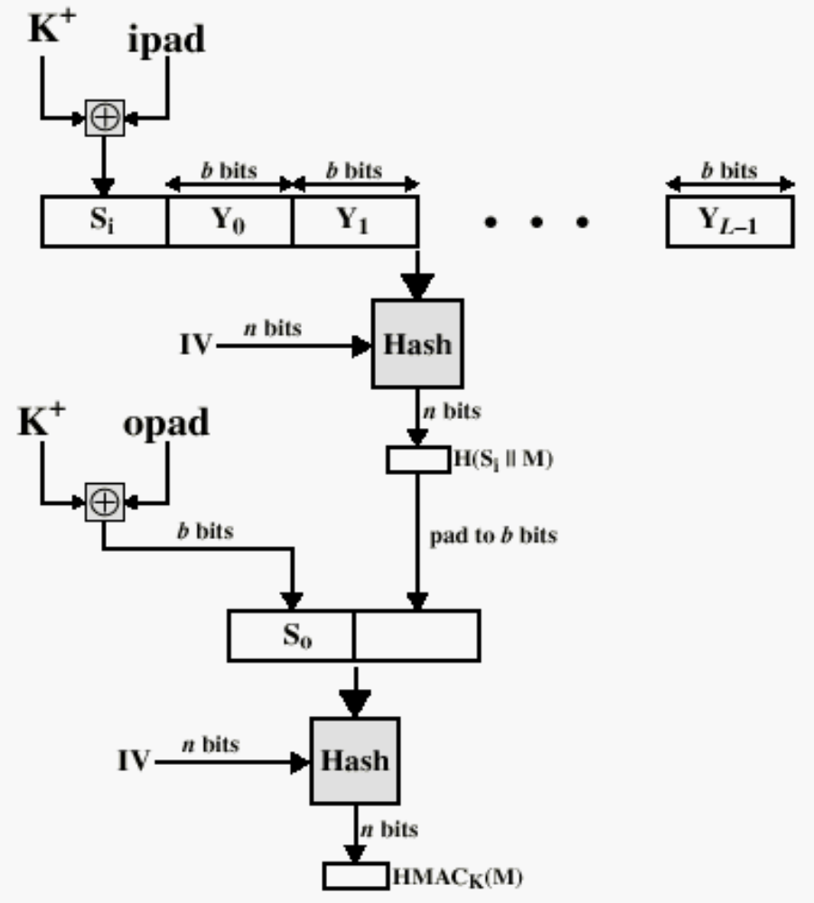
HMAC Structure
K+: secret K padded with 0’s on the left to make it b-bit long

